Slide 1

Unit 5

Slide 2
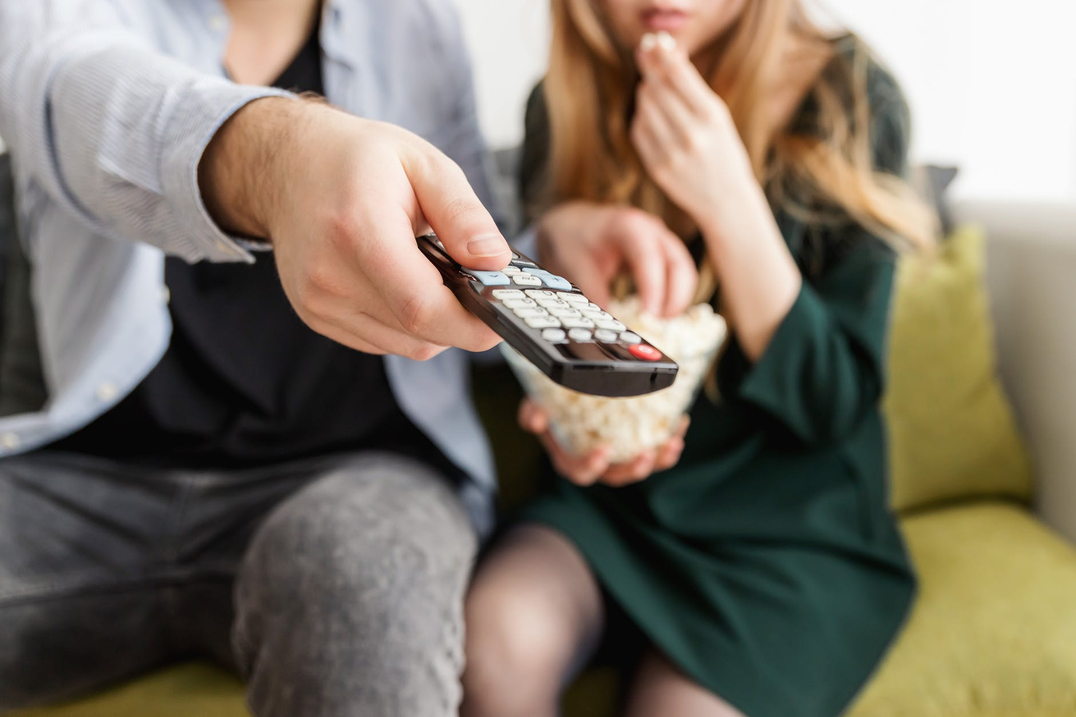
Unit 5
Do you want to
watch a game show?

Slide 3

Review
【计划】
A: Do you want to watch the news?
B: Yes, I do. / No, I don’t.
A: What do you plan to watch tonight?
B: I plan to watch Days of Our Past.
【对某种电视节目的看法】
A: What do you think of talk shows?
B: I don’t mind them./ I can’t stand them./ I love watching them.

Slide 4
【询问及说明原因】
A: Why do you like watching the news?
B: Because I hope to find out what’s going on around the world.
【深入谈论电视节目】
A: What can you expect to learn from sitcoms?
B: You can learn some great jokes.

Slide 5
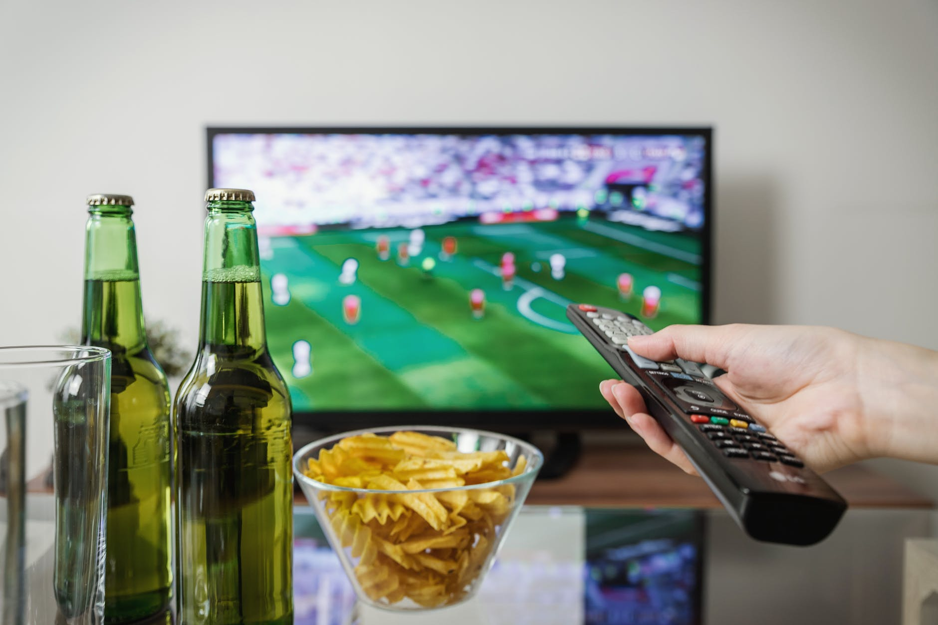


Slide 6

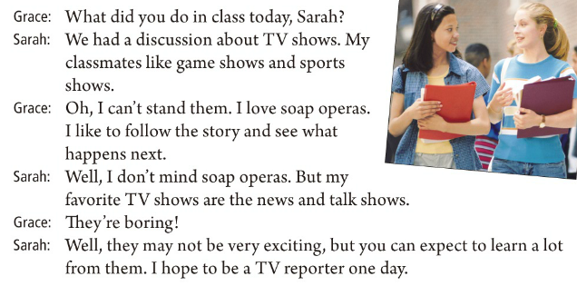

Slide 7

Listen to the conversation and match the persons with their favorite shows.
game shows and sports shows
Grace
Sarah
Sarah’s classmates
soap operas
news and talk shows

Slide 8
Read the conversation and answer the questions.
1. What are Grace and Sarah talking about?
2. What does Grace think of game shows and sports shows?
They are talking about TV shows.
She can’t stand them.
3. What does Grace think of soap operas, the news and talk shows?
4. What does Sarah think of soap operas?
5. Why does Sarah love news and talk shows best?
Grace loves soap operas and thinks the news and talk shows are boring.
Sarah doesn’t mind soap operas.
Because she learns a lot from them and she hopes to be a TV reporter one day.

Slide 10
Activity:Complete the sentences.
1. 你期望从情景喜剧中学到什么？
What can you ______ ______ ______ from sitcoms?
2. 你能学到一些很好的笑话。
You can ______ some great ______.
3. 你为什么喜欢看新闻呢？
Why do you like _______ _______ _______?
4. 因为我希望了解世界各地正在发生什么事情。
Because I _______ _______ _______ _______ what’s going on around the world.
expect to learn
learn jokes
watching the news
hope to find out

Slide 11
5. 你想看新闻吗？
Do you want to ______ ______ ______?
6. 是的，我想看。/ 不，我不想看。
Yes, I do. / No, I don’t.
7. 你计划今晚看什么节目？
______ do you ______ ______ watch tonight?
8. 我计划看《我们过去的时代》。
I ______ ______ watch Days of Our Past.
watch the news
What
plan to
plan to

Slide 12
9. 你觉得访谈节目怎么样？
What do you think of ______ ______?
10. 我不介意看。/ 我不能忍受。/ 我爱看。
I don’t _______ them. / I ______ _______ them! / I _______ ________ them!
talk shows
mind
can’t stand
love watching

Slide 13


Activity
Make a conversation and then practice it with a partner.
A: What do you plan to watch on TV tonight?
B: I hope to _________________, but I also want to _________________. How about you? Do you _________________ a talk show or _______________?
A: Oh, I want to _________________.
watch game shows
watch sports shows
want to watch
soap operas
watch soap operas

Slide 14

Answer these questions. Give answers that are true for you.
1. What do you think of game shows?
_______________________________________________
2. What comedy shows do you like to watch?
_______________________________________________
3. Do you plan to watch a sports show tonight?
_______________________________________________
4. What can you expect to learn from the news?
_______________________________________________
I love/like/don’t mind/can’t stand them.
I like to watch The Funnyman/Comedy Central Roast.
Yes, I do. I think it’s exciting./ No, I don’t.
I expect to find out what’s going on around the world.

Slide 16


To review:
talk about plans
talk about views on TV shows
ask and explain the reasons
talk about TV shows more deeply
To learn infinitives (to do) used as object:
--What do you plan to do…?
--I hope to …/I want to …/I plan to…/I expect to …

Slide 17
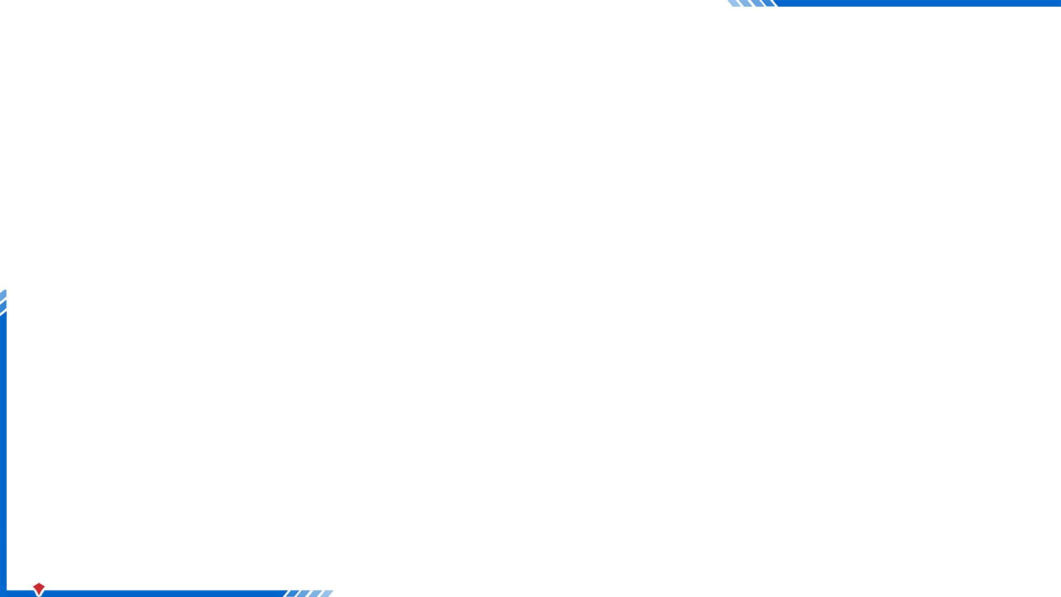

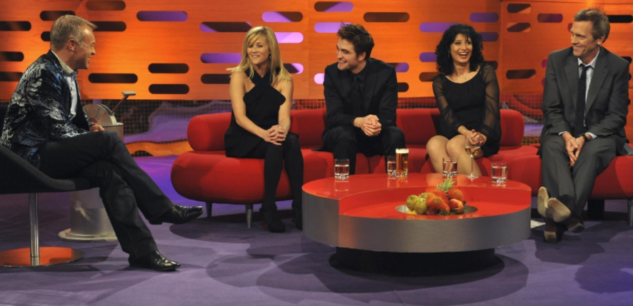

What does your partner think of talk shows?
He/She likes talk shows.

Slide 18


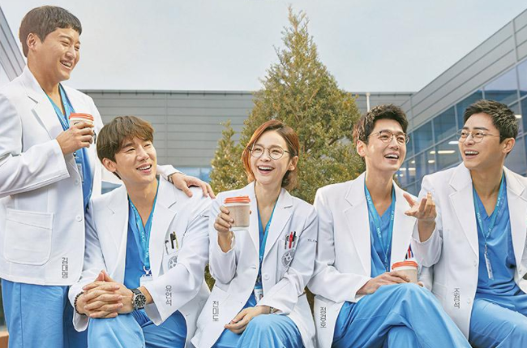

What do you think of talent shows?
I don’t mind them.
What does your father think of soap operas?
He can’t stand them. Because …

Slide 19
Complete the sentences.
1. My ___________ (最喜欢的) TV show is sitcom.
2. Jack ___________ (不介意) what others say behind him.
3. We must ___________ (弄清) when the earliest train leaves tomorrow.
4. He joined us in the ___________ (讨论) yesterday.
5. Are you for or against the ___________ (计划)?
favorite
doesn’t mind
find out
discussion
plan

Slide 20
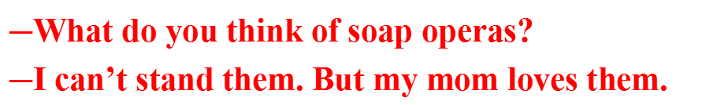
Translate the sentences.
1. 他希望不久能收到Tom的来信。
He hopes to receive Tom’s letter soon.
2. 她期待加入我们。
She expects to join us.
3. ―你认为肥皂剧怎么样？
―我不能忍受它们。但我妈妈很喜欢。
$\text{―}$What do you think of soap operas?
$\text{―}$I can’t stand them. But my mom loves them.

Slide 21


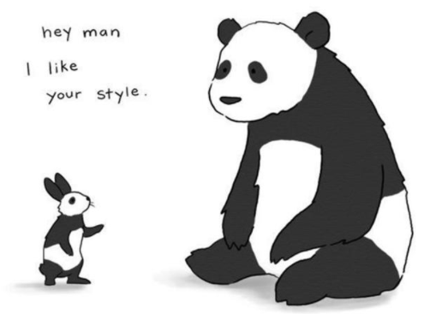
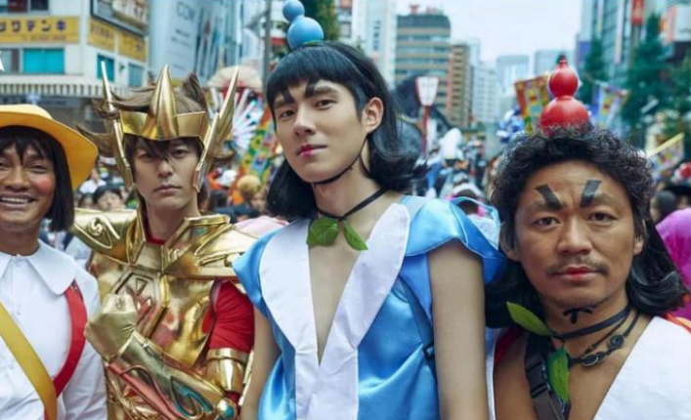
1. joke n. 笑话; 玩笑
tell jokes 讲笑话
play jokes on sb. = play a joke on sb.
与某人开玩笑
2. comedy n. 喜剧; 喜剧片

Slide 22
Complete the sentences.
want to watch
1. Do you _____________ the news?
2. What can you _____________ from sitcoms?
3. What do you ______________ tonight?
4. I _____________ Days of Our Past.
5. Because I ________________ what is going on outside.
expect to learn
plan to watch
plan to watch
hope to find out
主要行为动词后面的动词采用：to + 动词原形的结构，即动词不定式（有时可不带to）。

Slide 23


不定式
不定式有两种形式：一种是带to的不定式：to+动词原形；一种是不带to的不定式：动词原形。
不定式(短语)在句中不能单独作谓语，但可以作主语、表语、宾语、定语、状语等。本单元主要学习带to的不定式(短语)作宾语的用法。
e.g. David wants to study in the USA.

Slide 24
【温馨提示】
可跟带to的不定式作宾语的动词有：
like, love, want, hope, wish, expect, decide, try, plan, forget, remember, start, ask, help, need, learn, seem。
注意：help可接带to的不定式或不带to的不定式作宾语，其意思不变。
带to的不定式和what, which, who, where, when, how等疑问词连用，在句中起名词的作用，也可以作宾语。
e.g. I know how to make cakes.
Bob doesn’t know where to go tomorrow.

Slide 25
【语境应用】根据汉语意思完成英语句子。
1) He _______ _______ _______(学习弹) the piano when he was a boy.
2) It _______ _______ _______(开始下雨) an hour ago.
3) You _______ _______ _______ _______(不需要走) now. It’s just 5:00.
4) John _______ _______ _______ _______(似乎很高兴) after hearing the good news.
/learned
learnt to play
started to rain
don’t need to go
seemed to be happy

Slide 26
根据所给词语的提示填空。
1) We decided __________ (not go) out because of the bad weather.
2) I tried __________ (stop) her, but she was on her way to the teacher’s office.
3) —Do you remember __________(meet) her at my house last
year?
—Yes. She was short and strong at that time.
4) Sue enjoys __________(listen) to music after reading.
5) His spoken English is very good but he has to practice __________(speak) it more.
not to go
to stop
meeting
listening
speaking

Slide 27
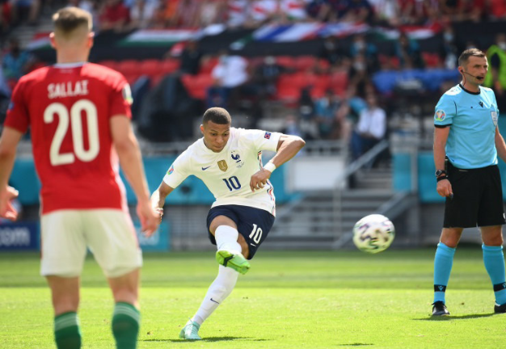
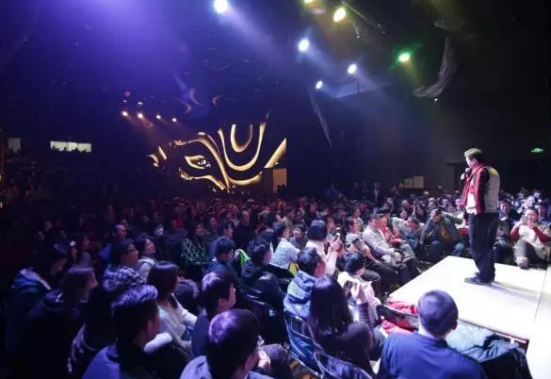
A: What do you plan to watch on TV tonight?
B: I hope to _______________, but I also want to _______________. How about you? Do you _______________ a talk show or _______________?
A: Oh, I want to _______________.

Slide 28
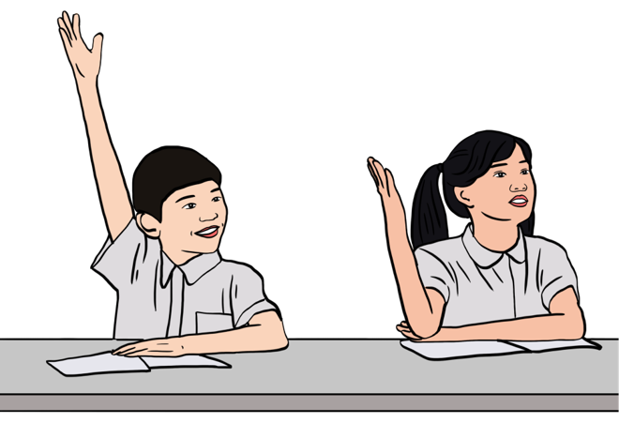
What do you plan to watch on TV tonight?
I hope to watch the soap operas, but I also want to watch a game show. How about you? Do you want to watch a sitcom or sports show?
Oh, I want to watch a sitcom.

Slide 29


Ask your classmates questions and write their names in the chart.
Find someone who … | Students’ names
wants to watch a movie
hopes to watch a sitcom
expects to watch the news
plans to watch a sports show
never wants to watch a game show

Slide 30
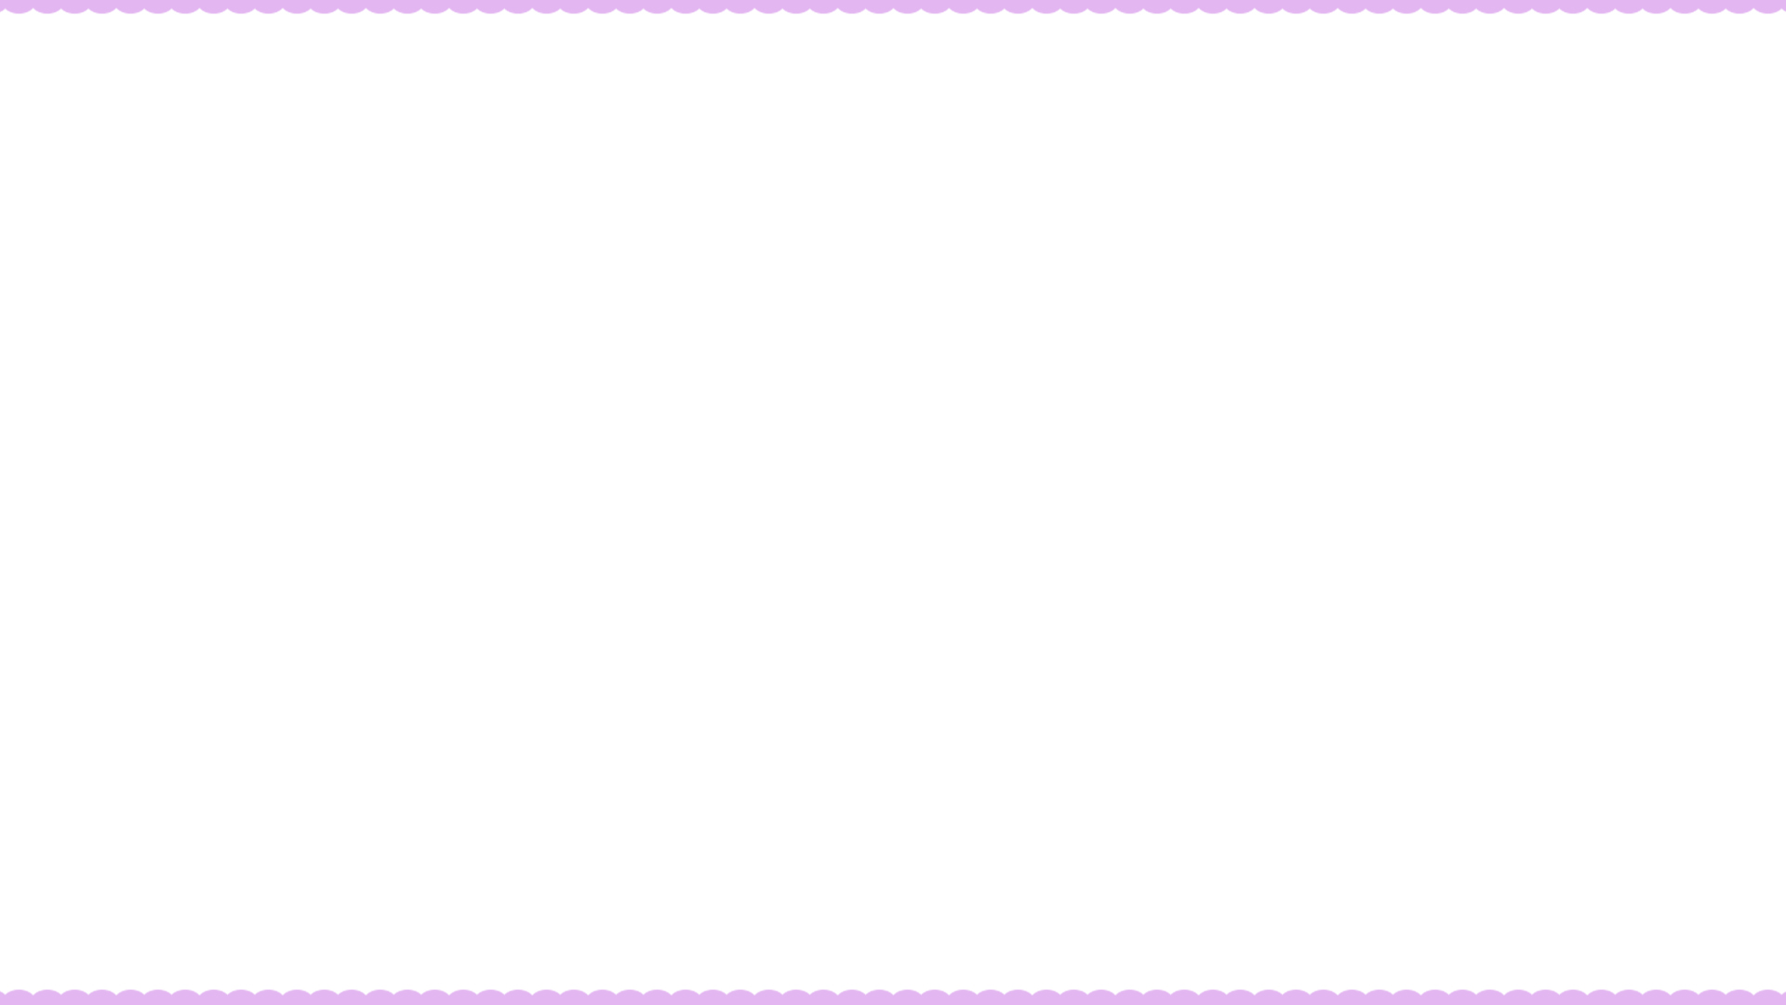

Ⅰ. 根据句意及括号内所给词的提示填空。
1. I happen _________ (know) John’s phone number. It’s 396-2366.
2. They seem _________ (have) lots of money.
3. I will call you after I finish _________(do) my homework.
4. I’m still looking for a job and I wish _________(find) one soon.
to know
to have
doing
to find

Slide 31
/ to rain
5. It started ___________ (rain) in the middle of the night.
6. The fine weather helped ___________ (make) it a very enjoyable trip.
7. She tried ___________ (not laugh), but failed (失败).
8. Would you like ___________(come) for dinner tonight?
raining
(to) make
not to laugh
to watch

Slide 32
Ⅱ. 根据短文内容及括号内所给单词的提示补全短文。
Hi John,
How are things going there? We’re all fine. And we can’t wait (1)_______(see) you again on New Year’s Eve. Dad plans (2)_______(buy) some fireworks (烟火) and we all want (3)_______(have) a meal in Mom’s favorite restaurant.
Now we’re enjoying (4)_______(have) a few days off. We need (5)_______(relax) and do some shopping. We also hope (6)_______(visit) Aunt Anne next week before we go back to work. But it depends (取决于) if it will snow or not.
to see
to buy
to have
having
to relax
to visit

Slide 33
It’s quite difficult (7)_______(get) to her house when there is snow. Usually she (8)_______(ask) us to wait until (直到) spring. She says she will come to visit us soon.
Oh, (9)_______(let) me know when you arrive and I will have Dad meet you at the train station. He will try (10)_______(get) there earlier.
Have a good day and see you on the 31st!
Steve
to get
asks
let
to get

Slide 34



What do your family members want to watch?
Do a survey.
My father doesn’t like soap operas. He loves watching news. He expects to …
My brother likes …, because …
My sister likes …
My grandma doesn’t like …
My grandpa loves …
My mother wants to watch soap operas. She thinks they are interesting.

Slide 35


